Slide 1
HDI and Canopy Cover in Worcester, MA
Jason Andrews
Geospatial Database Management
Spring 2024

Slide 2
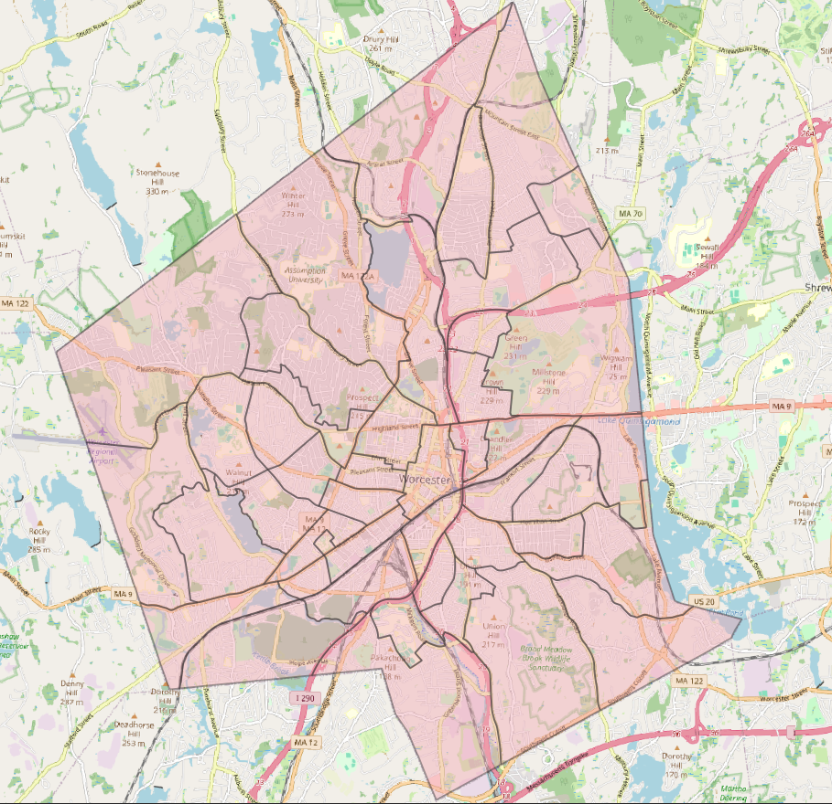
Objective:
Use ACS and CDC data to create a composite HDI index by census tract layer for Worcester, and compare this to metrics of urban canopy/greenness.
Study Area:
Worcester City limits, divided by 44 census districts from 2010
Idea:
EJ is great, but what about HDI?

Slide 3
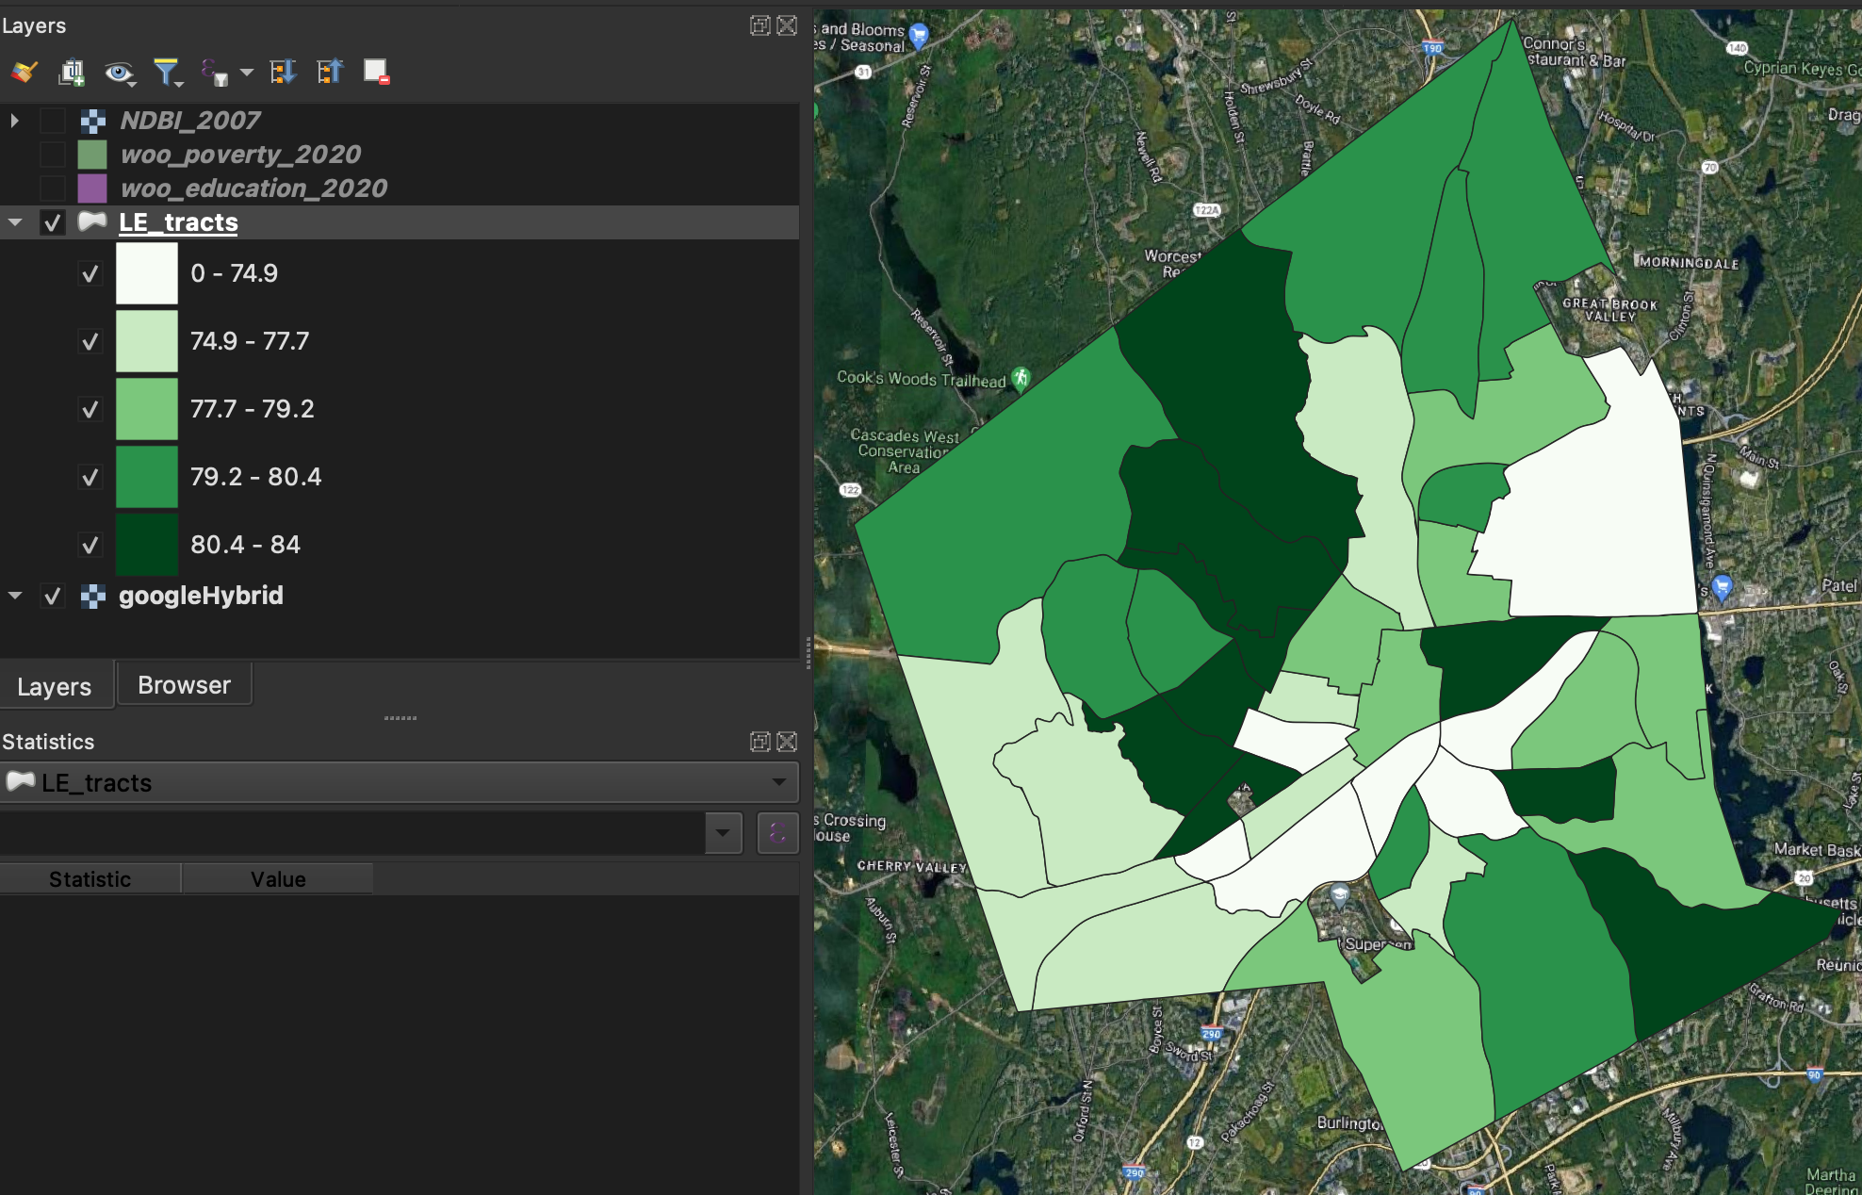
Data Acquisition
CDC Life Expectancy by Census Tract

Slide 4
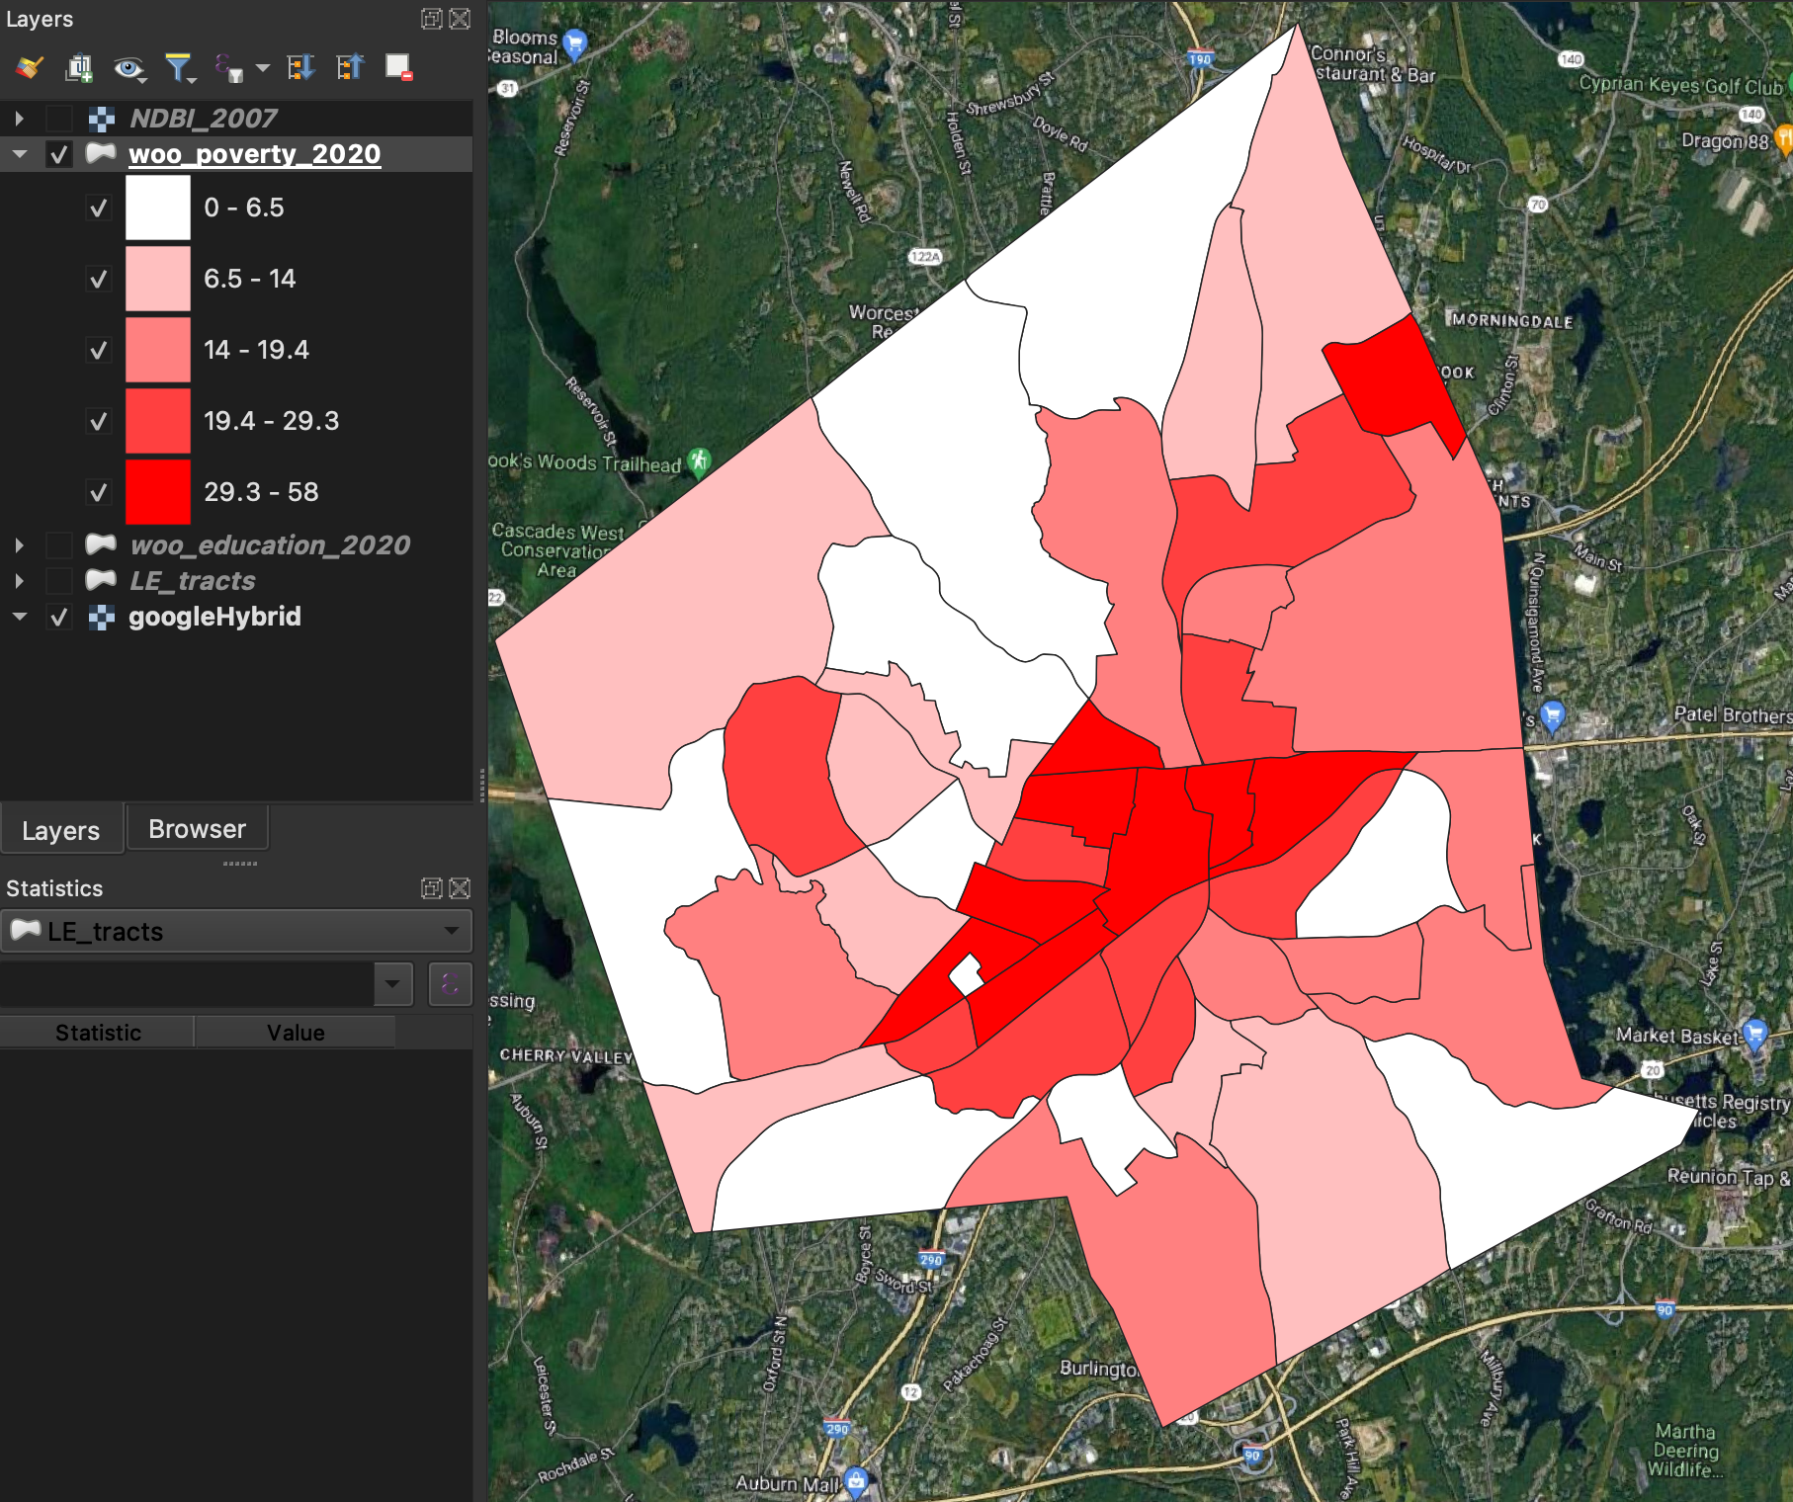
Data Acquisition
American Community Survey-- Percent of Population with Income below Federal Poverty Line

Slide 5
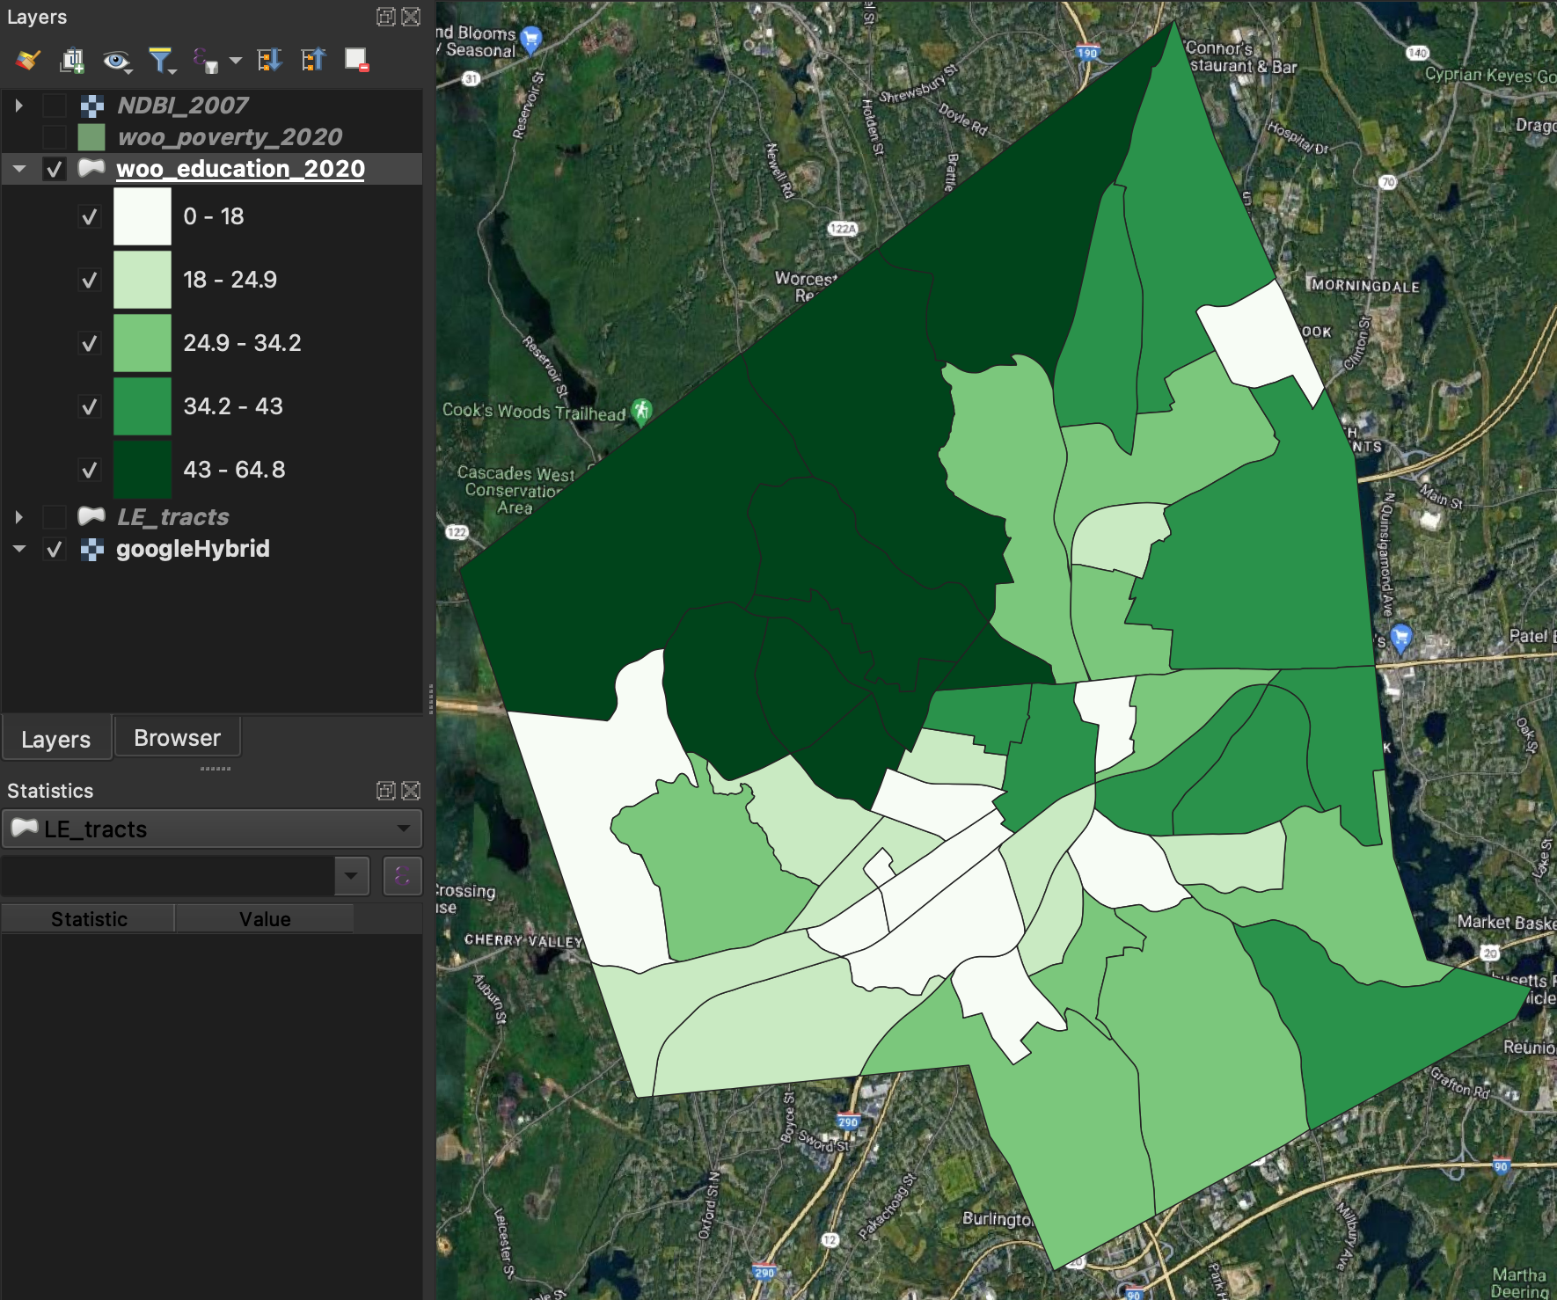
Data Acquisition
American Community Survey-- Percent of Population with Bachelor's Degrees

Slide 6
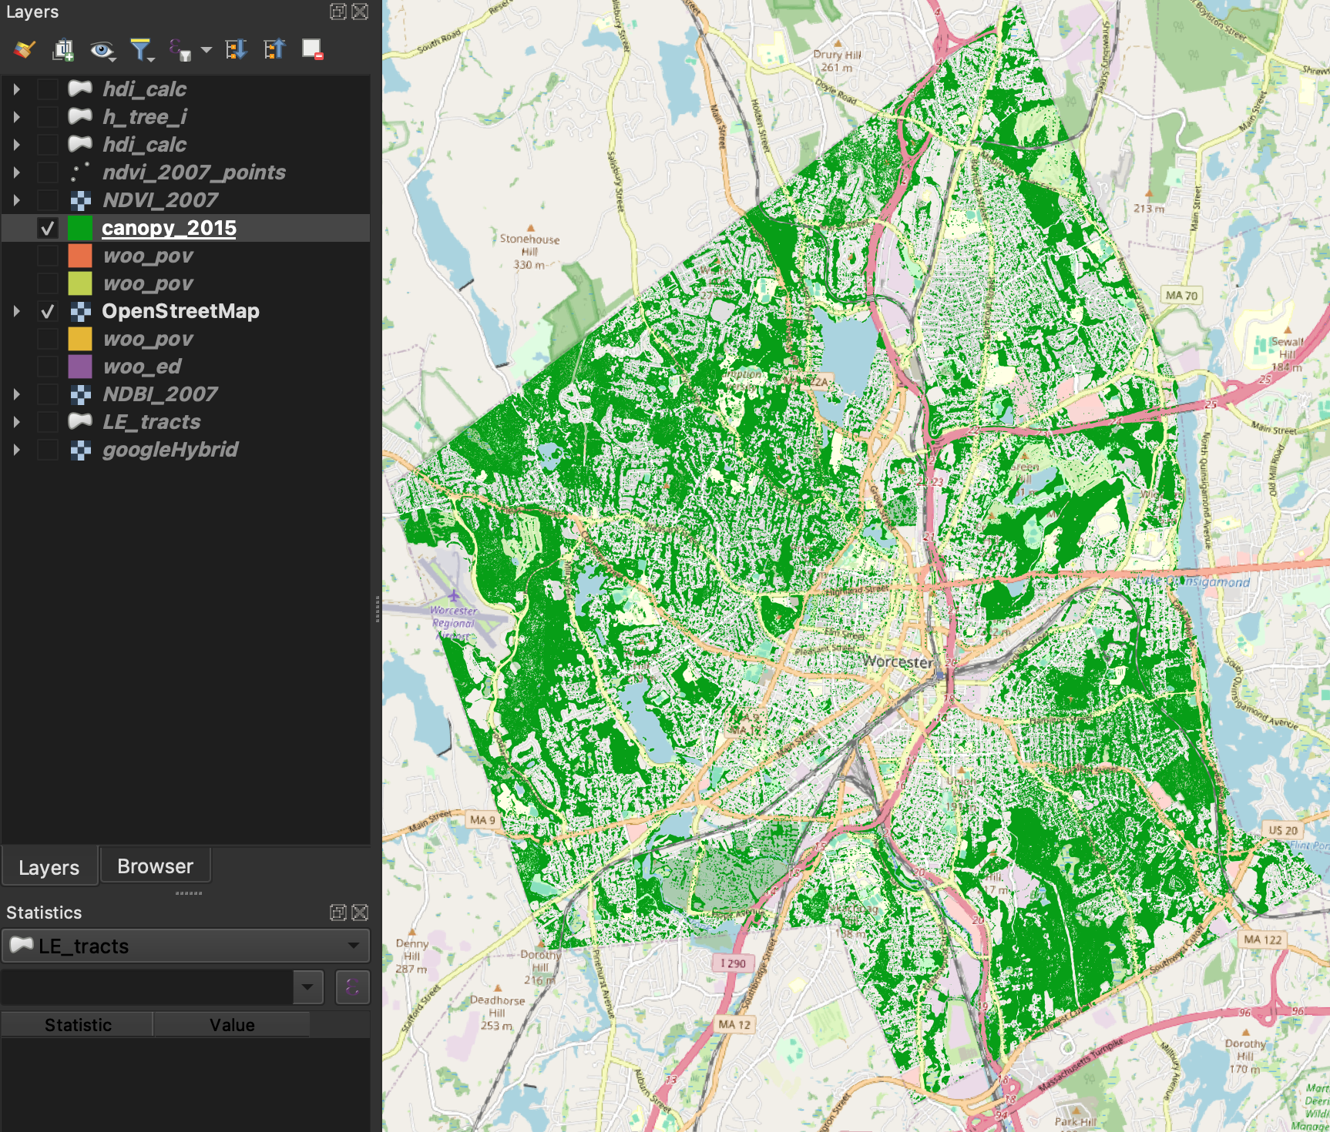
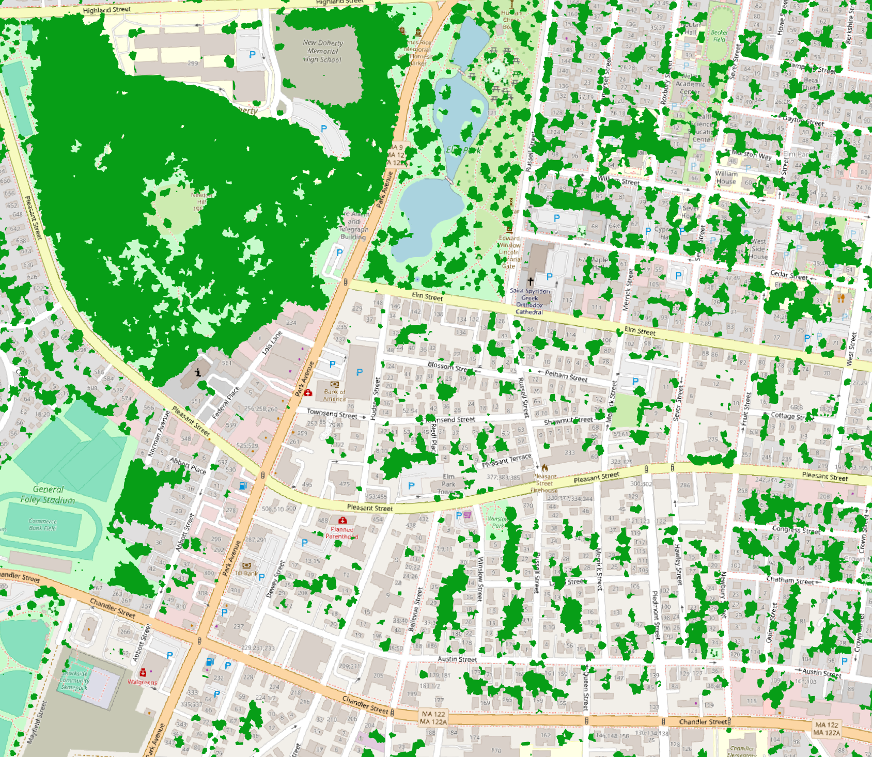
Data Acquisition
Canopy Cover Maps from 2007, 2010, and 2015– HERO (Elmes et al, 2017)
Detail:

Slide 7
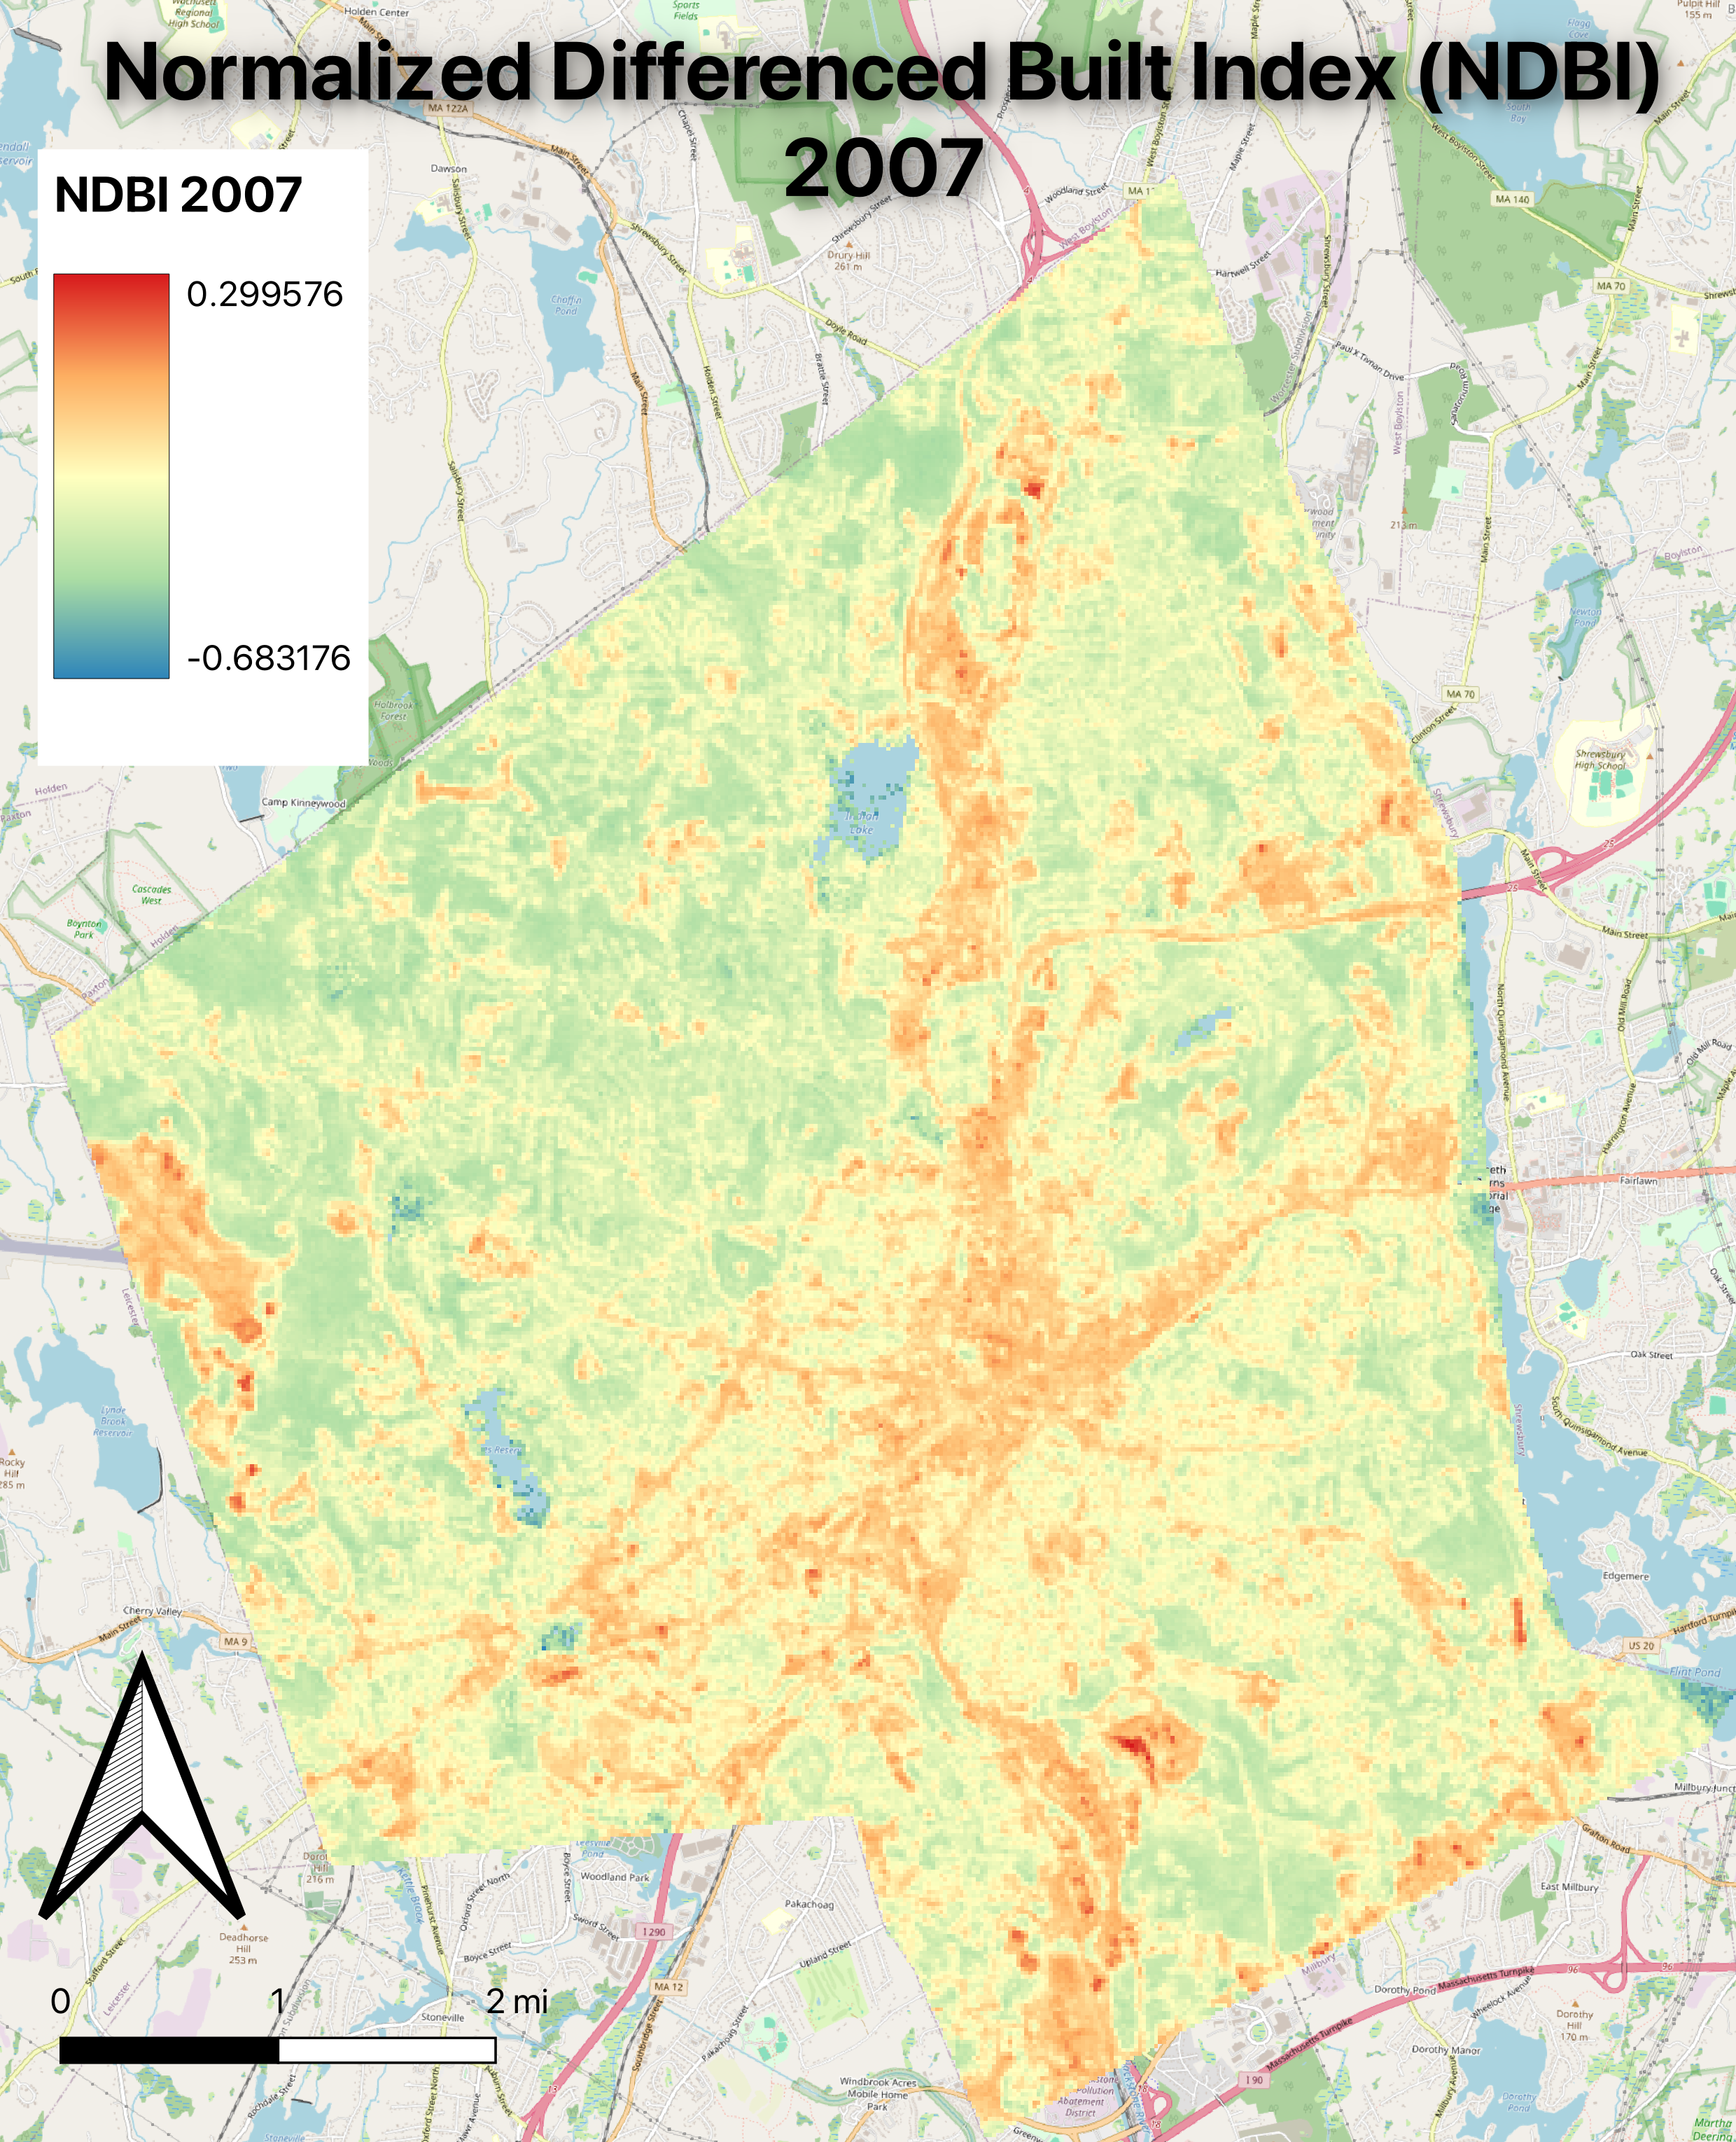
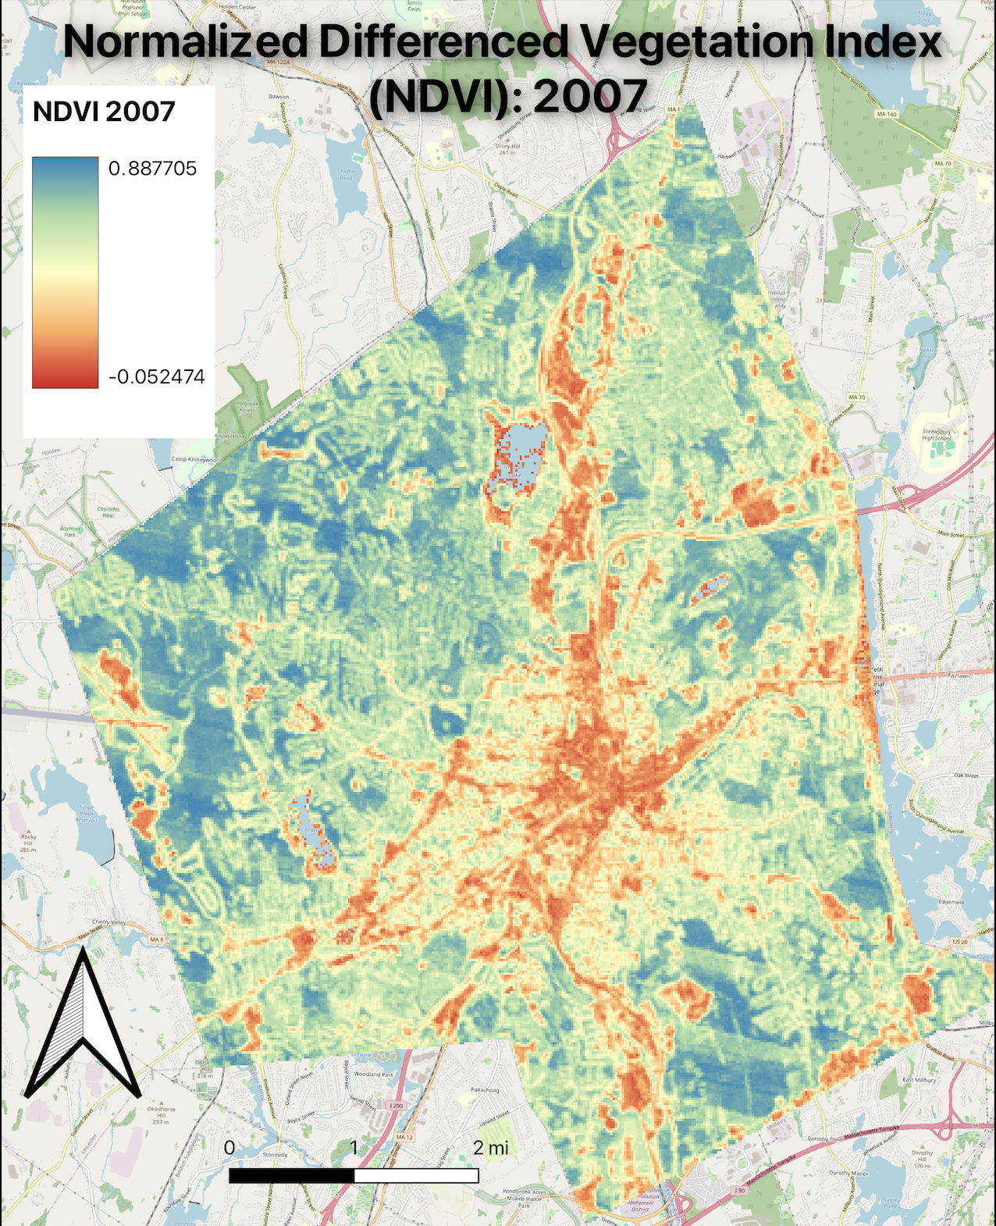
Data Acquisition
Raster Layers: NDBI, NDVI, UVI
2007, 2011, 2015, 2019, 2023

Slide 8
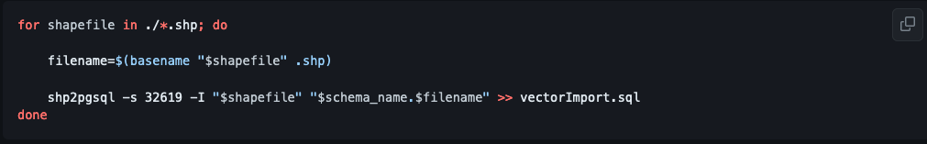
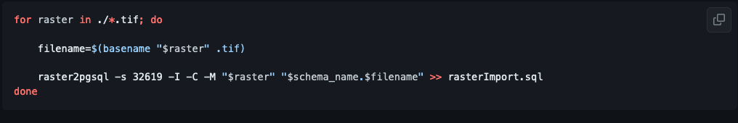
Importing Data – Batch Commands
Import all shapefiles in working folder:
Import all rasters in working folder:

Slide 9
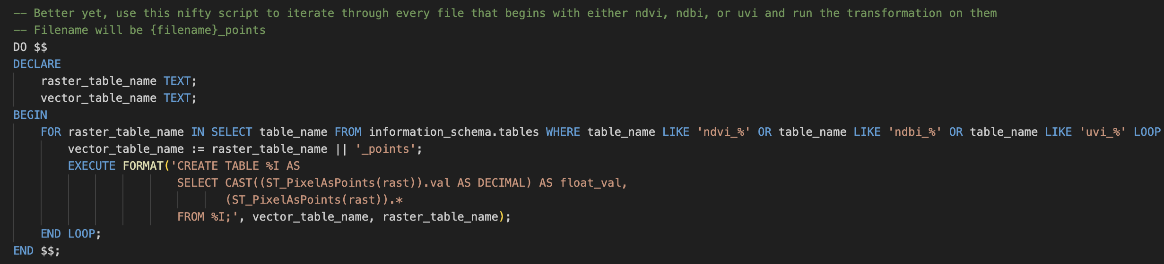
Raster to point– Batch Command
Grab every table that starts with ‘ndvi’, ‘ndbi’, or ‘uvi’ and feed it into ‘ST_PixelAsPoints’

Slide 10
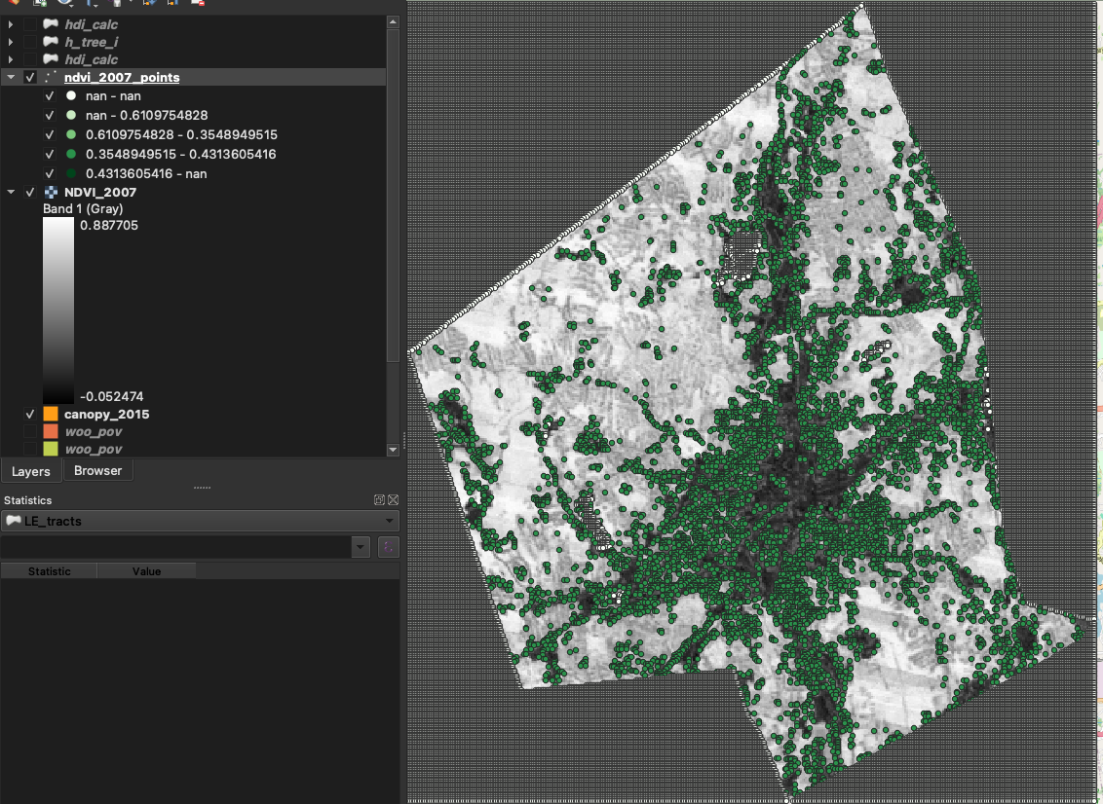
Trouble in paradise… Lots of ‘NaN’…

Slide 11
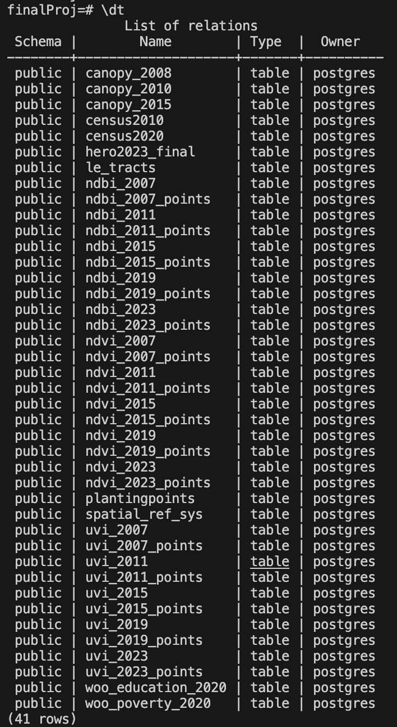
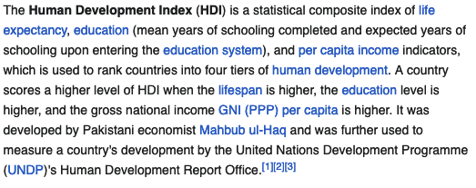

But we continue… towards HDI index by tract
Bring relevant columns on poverty rates, educational attainment, and life expectancy into one column. Index by ‘tract’

Slide 12
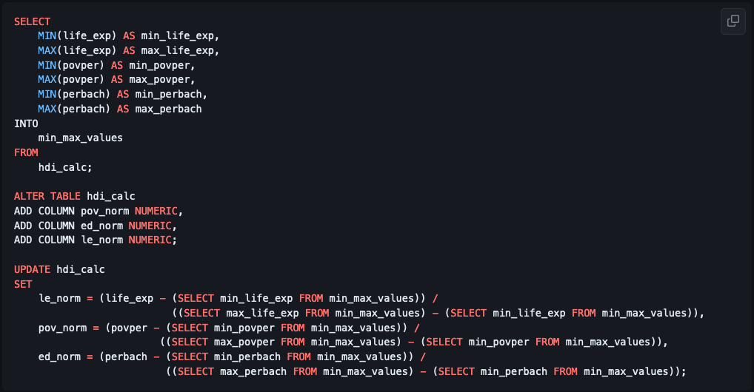
Normalize values to 0-1 Index– local Z score

Slide 13
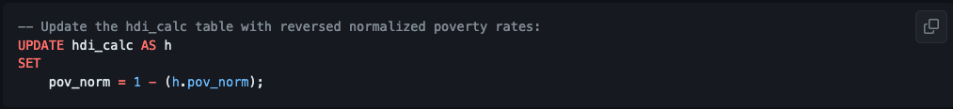
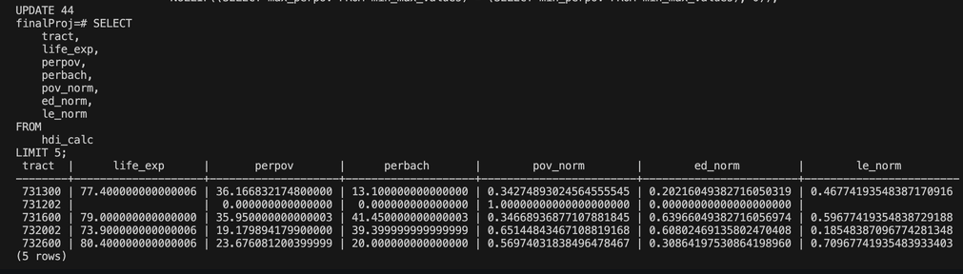
Poverty is bad, not good
We have to reverse that index
Which brings us to here: (Now higher percent pov = lower pov_norm value)

Slide 14
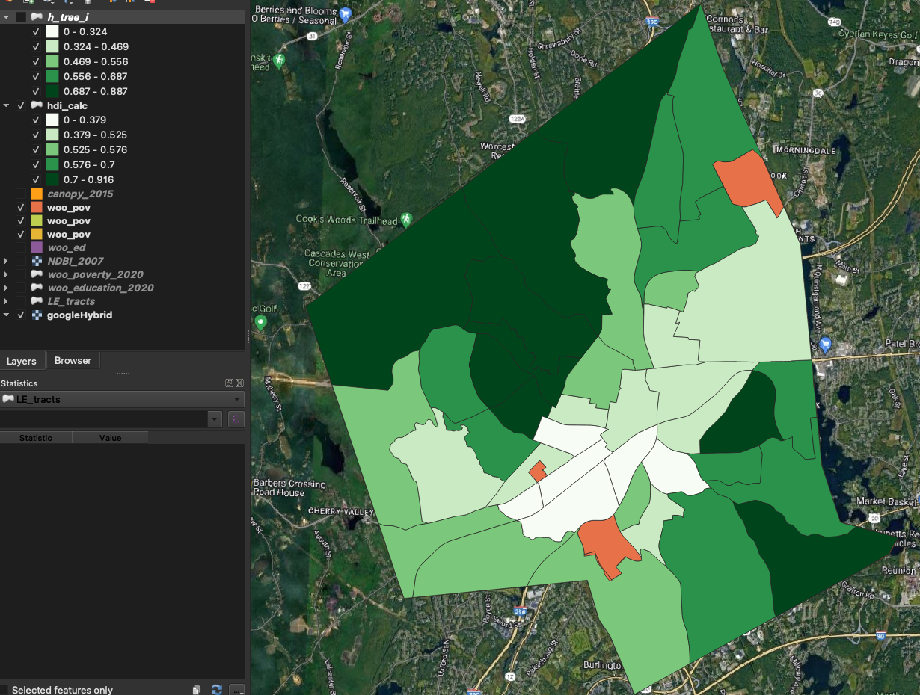
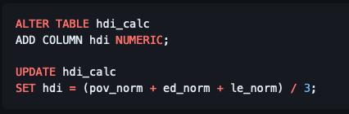
Calculate NDI by Tract, add to same table

Slide 15
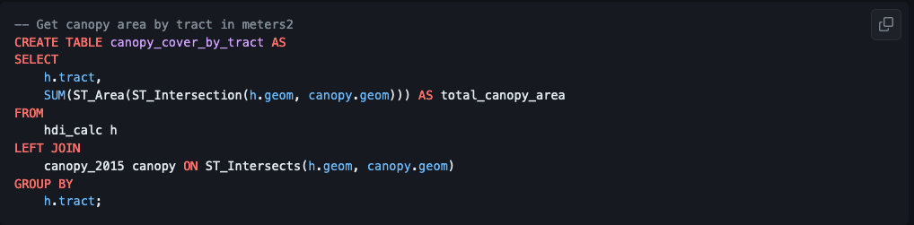
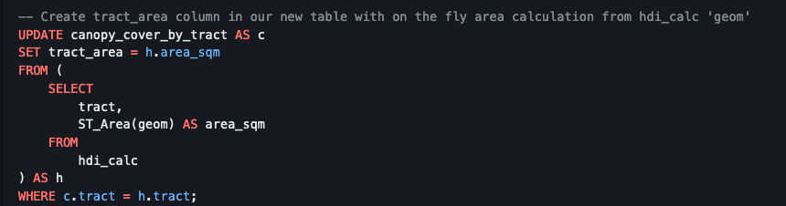
Back to canopy– Calculate % canopy by tract
- First, area by tract
- New table, same primary key of ‘tract’
- Bring in tract area column

Slide 16
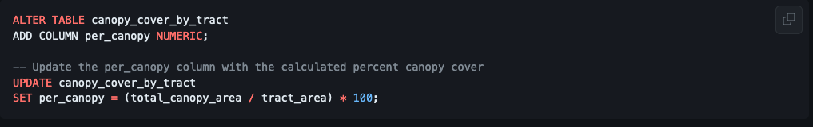
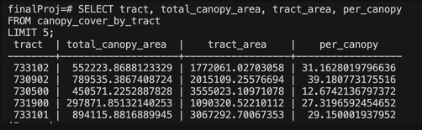
And Percent Canopy by Tract
- This is what canopy_cover_by_tract looks like now:

Slide 17
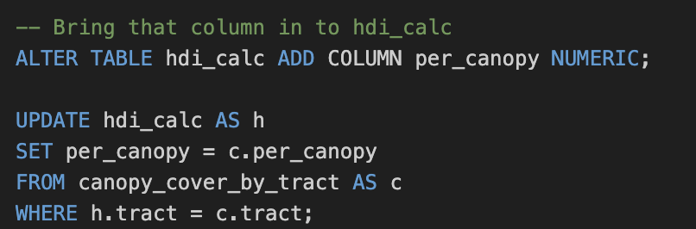
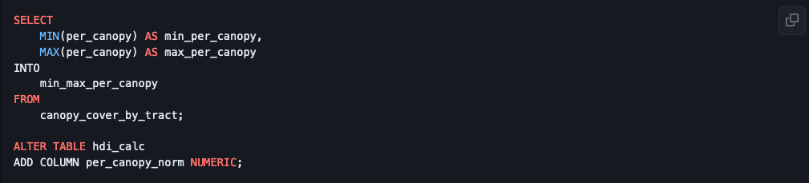
Bring Canopy % in as column on hdi_calc
- And normalize to 0-1 index

Slide 18
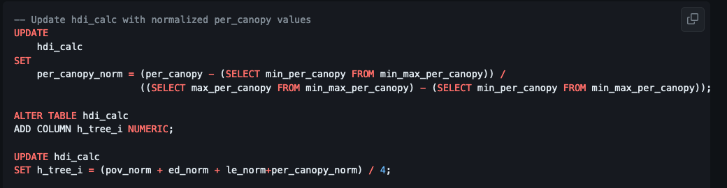
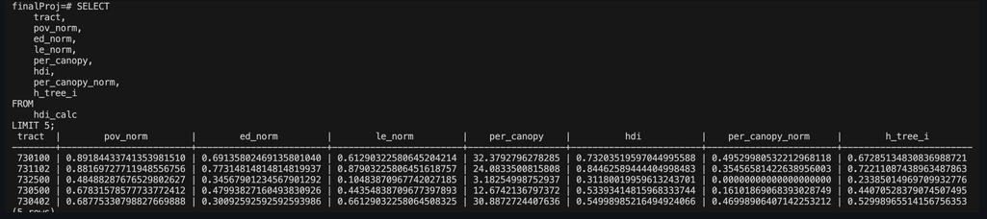
And now we can calculate ‘H Tree I’
- All data in one table

Slide 19
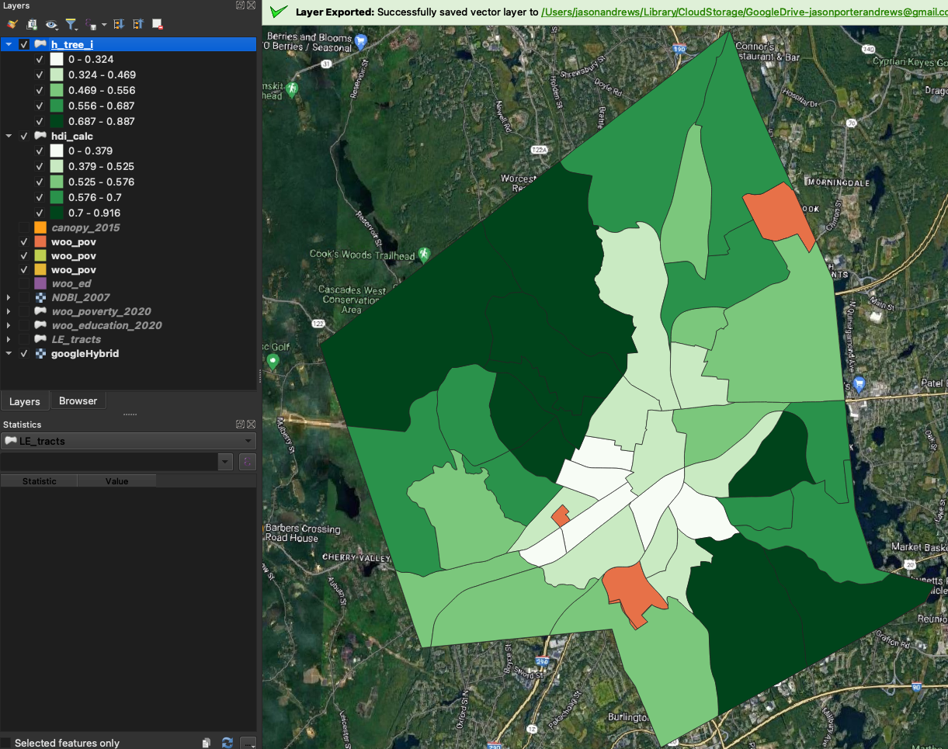
Visualizing H Tree I

Slide 20
Versus HDI

Slide 21
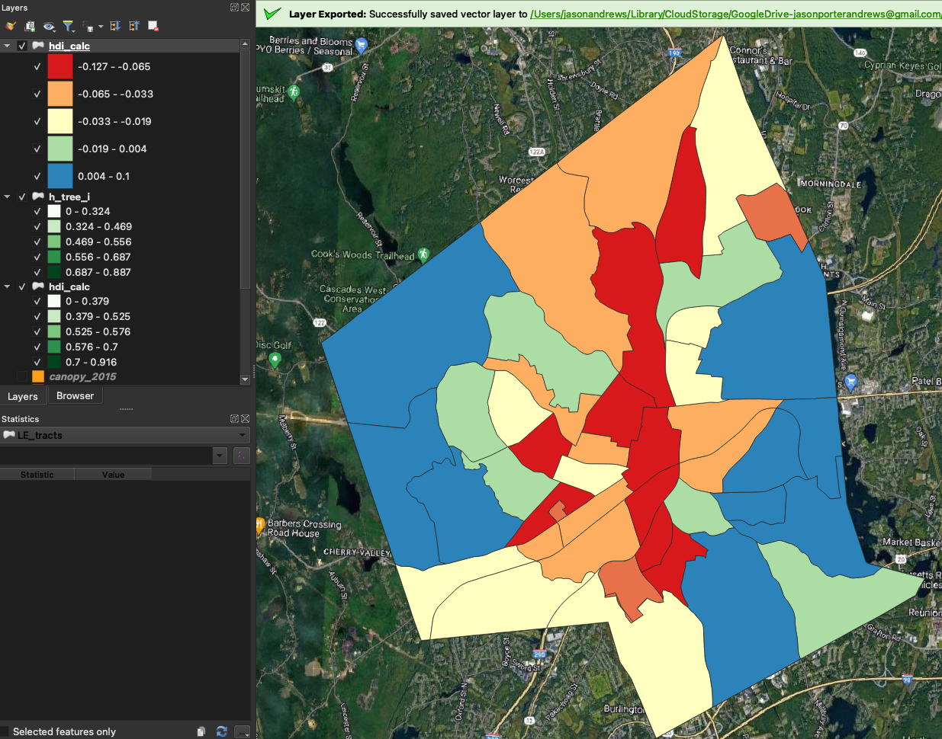
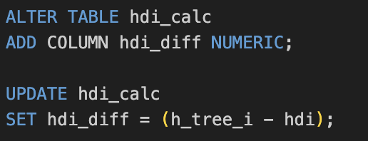
What about HDI Diff?
At first blush, it appears as though the areas that declined more with the addition of canopy cover largely coincide with areas that already score on the low end of HDI.
But let’s take a closer look…

Slide 22
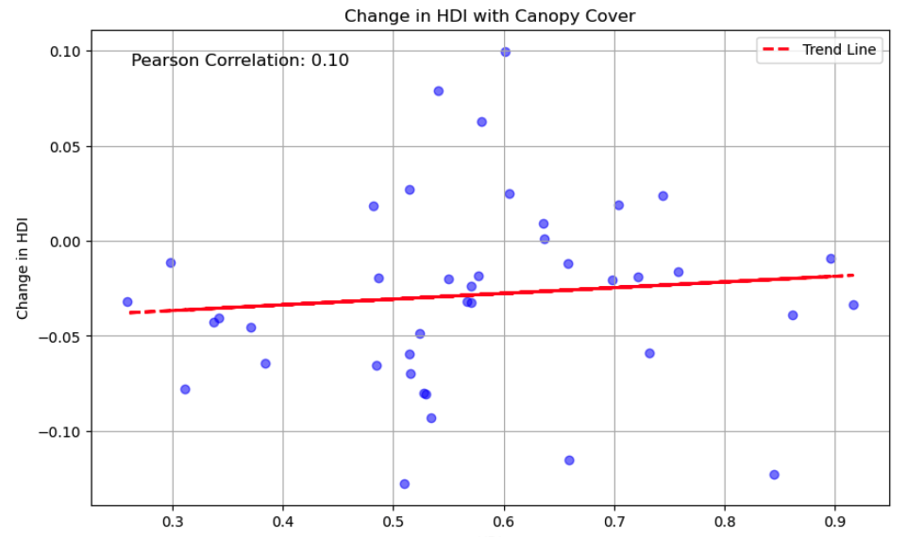
The rich get richer and the poor get poorer…
As initial HDI increases, so does the amount that the metric increases when you add canopy cover index

